Slide 1

Design a Fuzzy Logic Controller for a
Rotary Flexible Joint Robotic Arm
Prof: Dr.Sharifi
Students:
Niloofar Tavahodi
Mohammad Arabzadeh
Arshia Samodi
Mahban Jafari

Slide 2
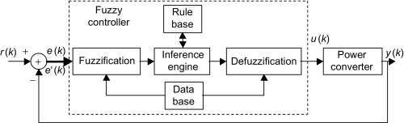
Abstract
The purpose of this research is to design a fuzzy logic feedback controller (FLC) in order to control a desired tip angle position a rotary flexible joint robotic arm.
The FLC is also employed to dampen the vibration emanated from a rotary flexible joint robotic arm when reaching a desired tip angle position. The performance of FLC is tested in simulation and experiment. It is found that the FLC is successfully designed, applied and tested. The results show that fuzzy logic controller performed satisfactorily control a desired tip angle position and reduce the oscillations.

Slide 3
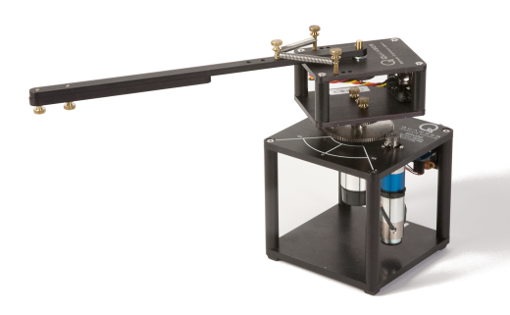
Introduction to SRV02
The Quanser Rotary Flexible Joint module consists of a rigid beam mounted on a flexible joint that rotates via a DC motor. The joint deflection is measured using a sensor.
The sensor shaft is aligned with the motor shaft. One end of a rigid link is mounted to the sensor shaft. The link rotation is counteracted by two extension springs anchored to the solid frame resulting in an instrumented flexible joint.
9 possible stiffness values
The link is also adjustable in length thus allowing for variations in inertia.

Slide 4
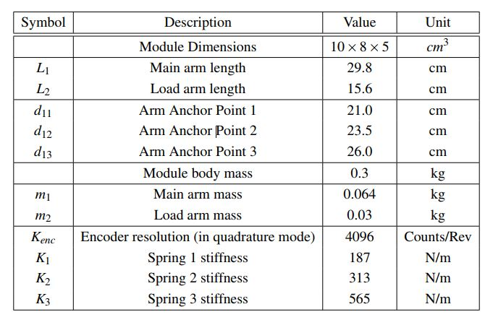
2. System Specification

Slide 5
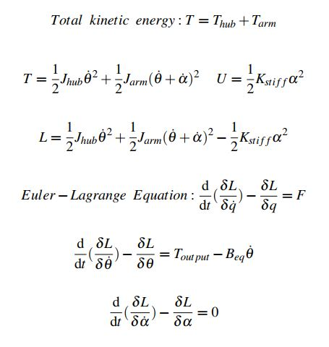
3.Equation of Motion
Elegant and powerful methods have also been devised for solving dynamic problems with constraints. One of the best known is called Lagrange’s equations. The Lagrangian L is defined as L = T - V, where T is the kinetic energy and V the potential energy of the system in question.

Slide 6
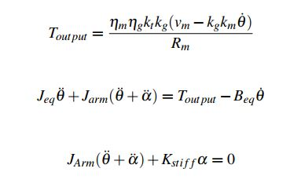
4.System Equations

Slide 7
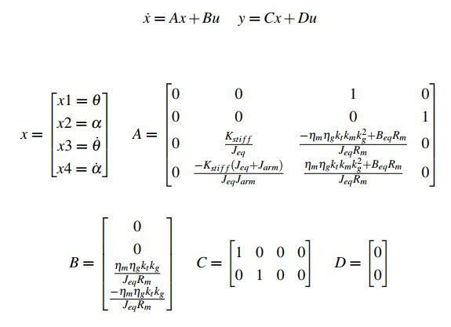
5.State Space Equations

Slide 8
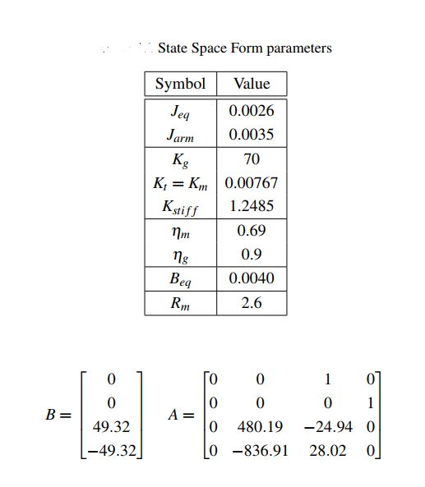
5.State Space Equations

Slide 9
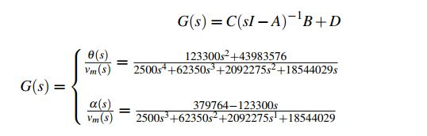
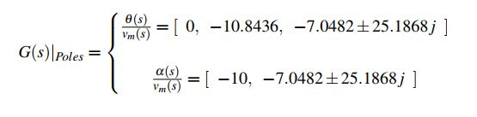
6. Transfer Function
From the below equation, the Transfer function will be obtained:
Poles of Two Transfer Function are Listed Below:

Slide 10
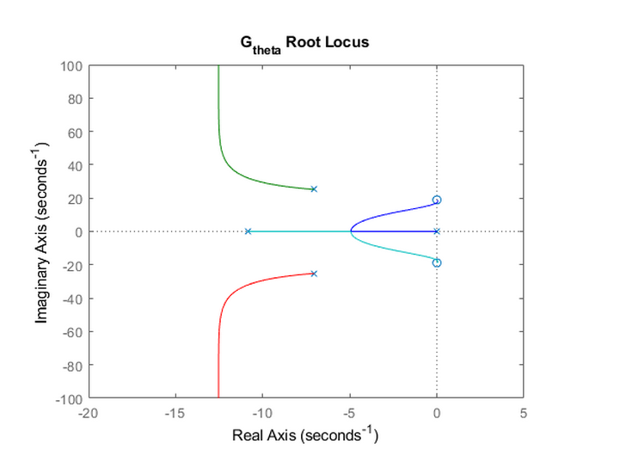
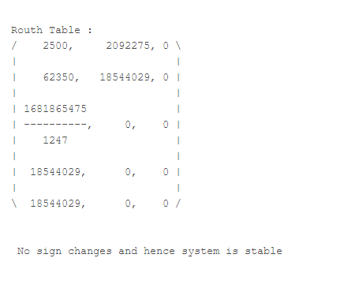

7.System Stability
Stability of $G_{θ}$
Routh Hurwitz Stability
Root Locus Stability (Stable for k<50)

Slide 11
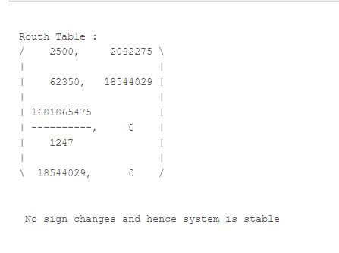
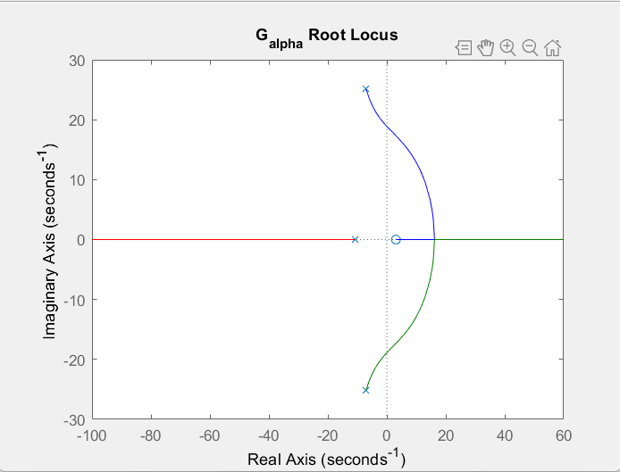

7.System Stability
Stability of $G_{α}$
Routh Hurwitz Stability
Root Locus Stability (Stable for k<10)

Slide 12
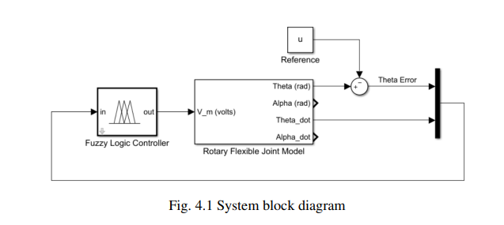
8.Fuzzy Controller Design
The goal of this project is to track the desired angle in a rotary flexible joint robotic arm with fuzzy systems.
System block diagram

Slide 13
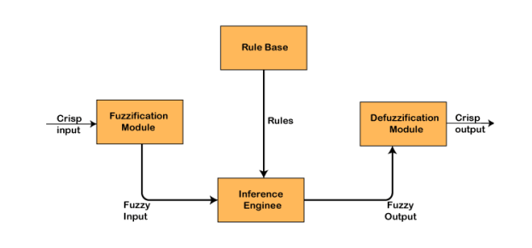
8.Fuzzy Controller Design
In general, the fuzzy controller has four components :
The fuzzification module
The rule base
The interface engine
The defuzzification module

Slide 14
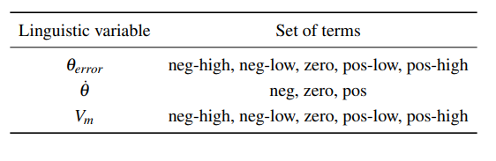
9. Fuzzy Mamdani Controller
Input and Output Variables and Set of Terms
Set of terms for the linguistic variables

Slide 15
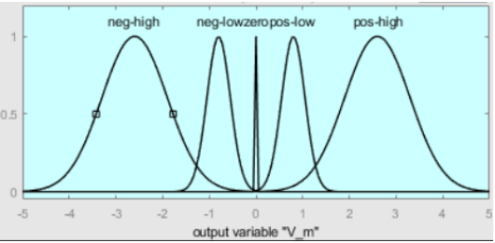
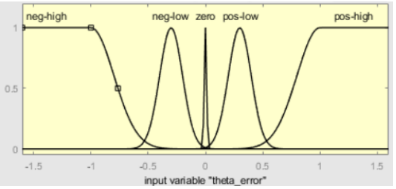
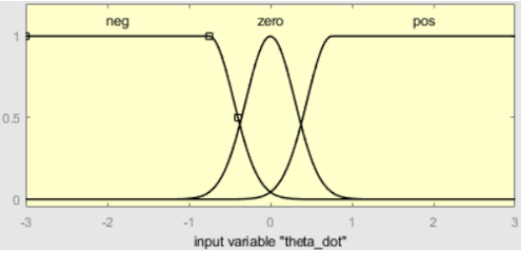



9. Fuzzy Mamdani Controller
Membership Functions
$Vm$ membership functions
$θerror$membership functions
$\dot{θ}$ membership functions

Slide 16
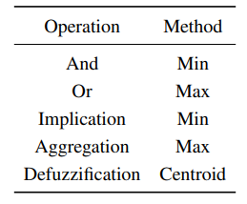
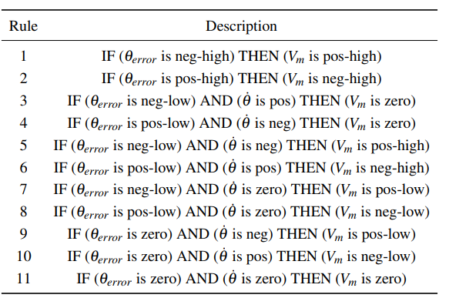
9. Fuzzy Mamdani Controller
Inference Engine
Rule Base
Logical methods for the inference engine
The fuzzy logic controller rule base

Slide 17
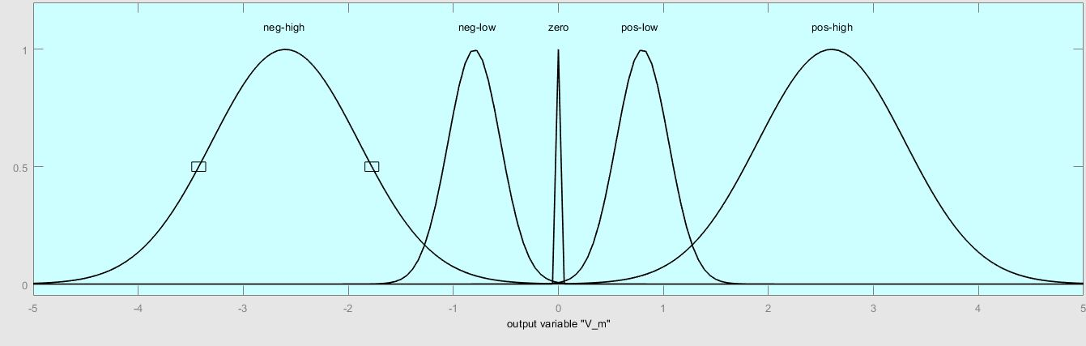
Stability Conditions Based On Lyapunov Approach
The equilibrium of a continuous fuzzy system is asymptotically stable in the large if there exists a common positive definite matrix P such that
For i = 1, 2,. . . , r, i.e., for all the subsystems. In our system:

Slide 18

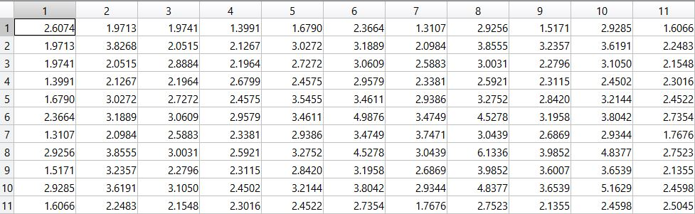
Stability Conditions Based On Lyapunov Approach
For P to be positive definite we wrote a MATLAB code:
The appropriate P is:

Slide 19
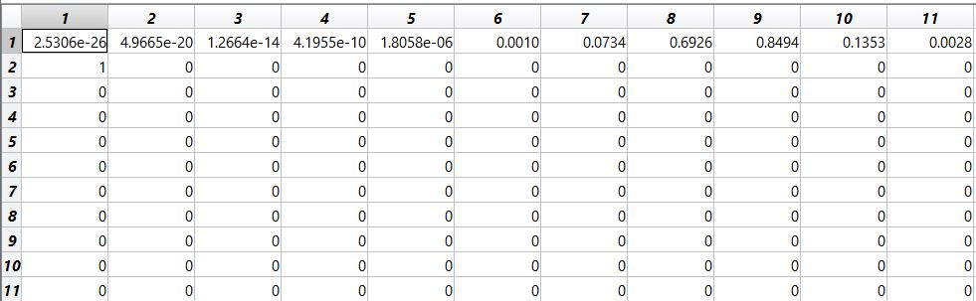
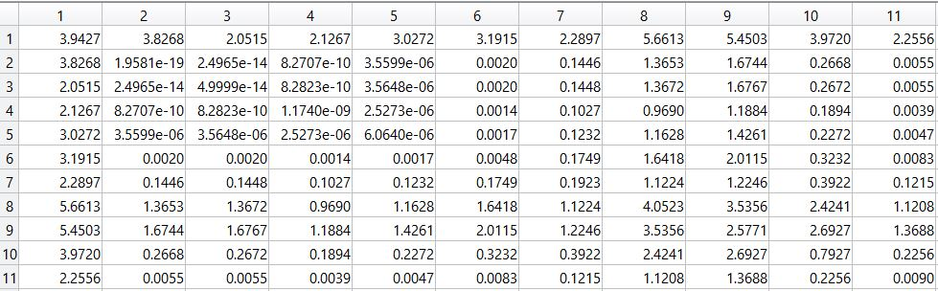
Stability Conditions Based On Lyapunov Approach
For pos-high:
Then

Slide 20
Stability Conditions Based On Lyapunov Approach
After testing each 5 subsystems, we can say that the fuzzy system is asymptotically stable.

Slide 21
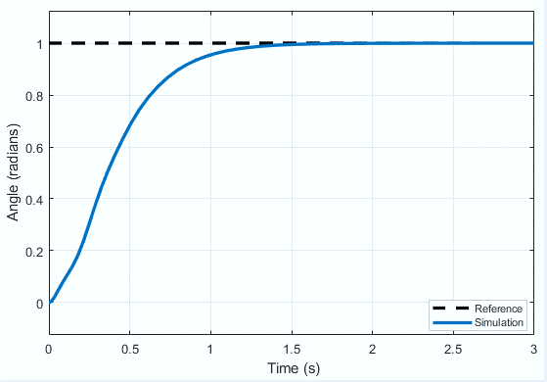
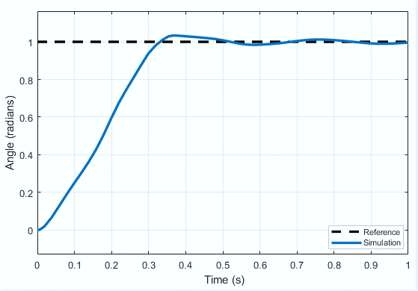
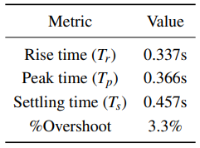
Results- Step Response
The step response of the system without and with the fuzzy logic controller:
The controlled system transient state behavior

Slide 22
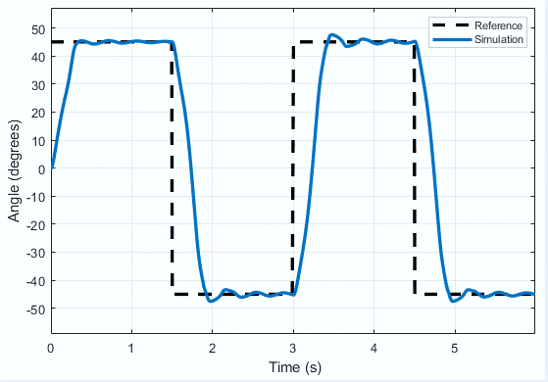
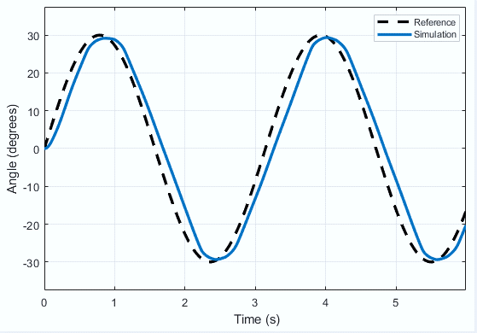
Results- Angle Tracking Performance
we’ve simulated the system with different input references to evaluate the controller performance under various situations. Outputs with pulse and sine inputs respectively:

Slide 23
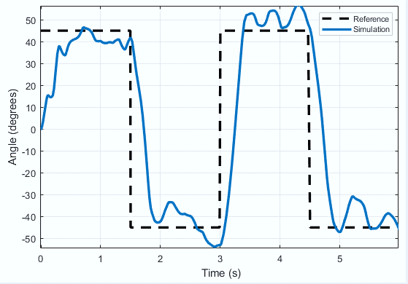
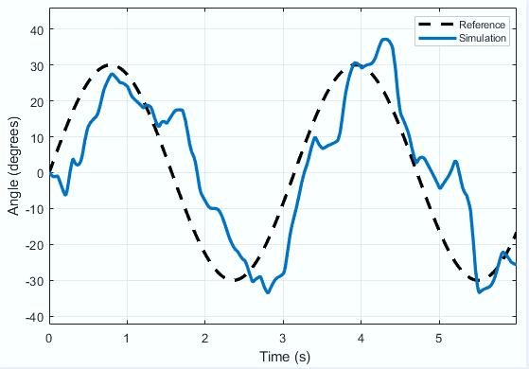
Results- Angle Tracking Performance
The outputs of the same inputs, but with white Gaussian noise added to the system’s feedback loops.

Slide 24
Conclusion
The results showed that fuzzy controller performed satisfactorily to suppress the oscillations. In future, the FLC should be further tuned so that the performances for servo load angle and arm deflection angle become better.

Slide 25
Thanks!
Any questions?

